Slide 1
Encryption Controls
Mohamed Sharaf
CSA

Slide 2
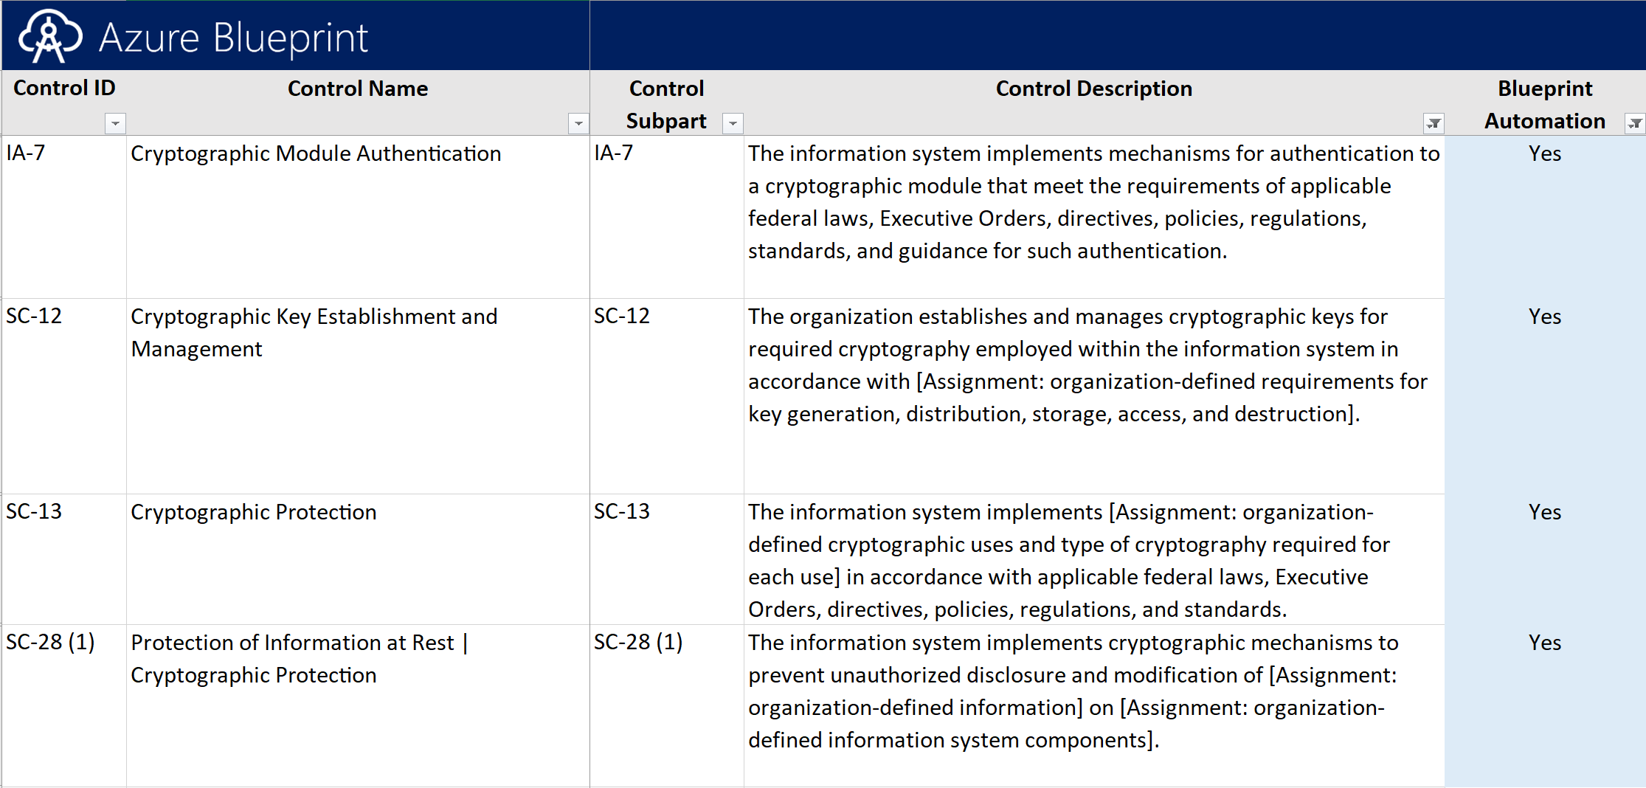

Slide 3
Azure Key Vault

Slide 4
WHY Azure Key Vault
Organizations need to safeguard certificates/keys deployed into their VMs or VM disk
Developers need to safeguard config secrets of their Azure cloud services.
Organizations need to control encryption keys used by their OWN apps.
Organizations need to control encryption keys used by SaaS services.

Slide 5
What is Azure Key Vault?
An Azure resource provider that lets you
Store & manage SECRETS (esp app config), and release them at runtime to authorized apps & users.
Store & manage KEYS, and perform cryptographic operations on behalf of authorized apps & users.
Backed by Hardware Security Modules
All secrets and keys are protected at rest with key chain terminating in HSMs.
Keys marked as ‘HSM-protected’ are protected even at runtime with HSMs.
Key Vault ≠ customer’s dedicated HSM
Azure Key Vault is a multi-tenant service backed by Microsoft-managed HSMs.

Slide 6
Terminology
Secret
What: Any sequence of bytes under 25KB. E.g. SQL connection string, Storage account key.
How used: Authorized users/apps write and read back the secret value.
Key
What: A cryptographic key. RSA 2048.
How used: A key cannot be read back. Caller must ask the service to decrypt / sign with the key.
Certificate (Managed Key & secret)
What: x509 certificates
How used: Generate self-signed certificates or import from CA. Key Vault can manage the renewal from some certificate issuers

Slide 7
Secrets
Octet sequences with a maximum size of 25k bytes each
KV will accept the byte array, encrypt them and store them
Support ContentType field for secret type identification
Secrets can have optional not-before-date, expiry dates and enabled bit
Secrets permissions
set: Create new secrets
get: Read a secret
list: List the secrets or versions of a secret stored in a Key Vault
delete: Delete the secret
all: All permissions

Slide 8
Keys
Types
RSA : 2048 bit RSA Key
Processed in in software
At the end of the chain, protected by the HSM
Validated to FIPS 140-2 Level 1
RSA-HSM
Processes in HSM
Available for premium Vaults
Validated to FIPS 140-2 Level 2

Slide 9
Key operations
ARM resource operations
Create List
List versions Restore
Get Import
Backup Update
Delete
Cryptographic Operations
Sign and Verify: hash sign or hash verify
Key Encryption / Wrapping:
Encrypt and Decrypt

Slide 10
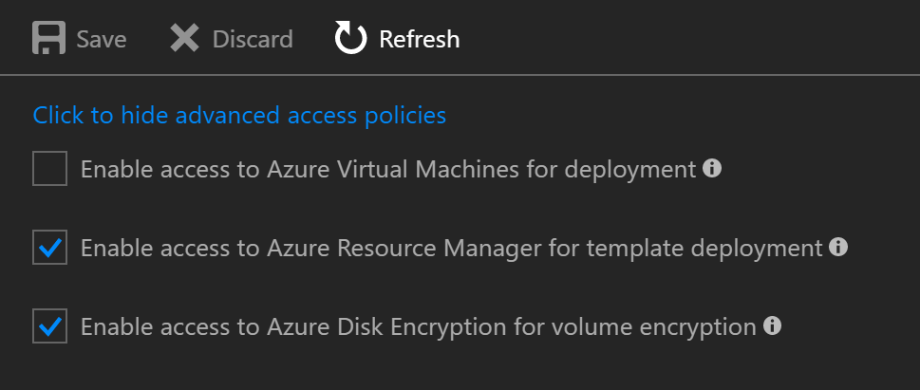
Advanced Access Policy
Access Policies to Azure Key Vault to perform certain actions

Slide 11
Demo
How GC Blueprint implemented Key Vault

Slide 12
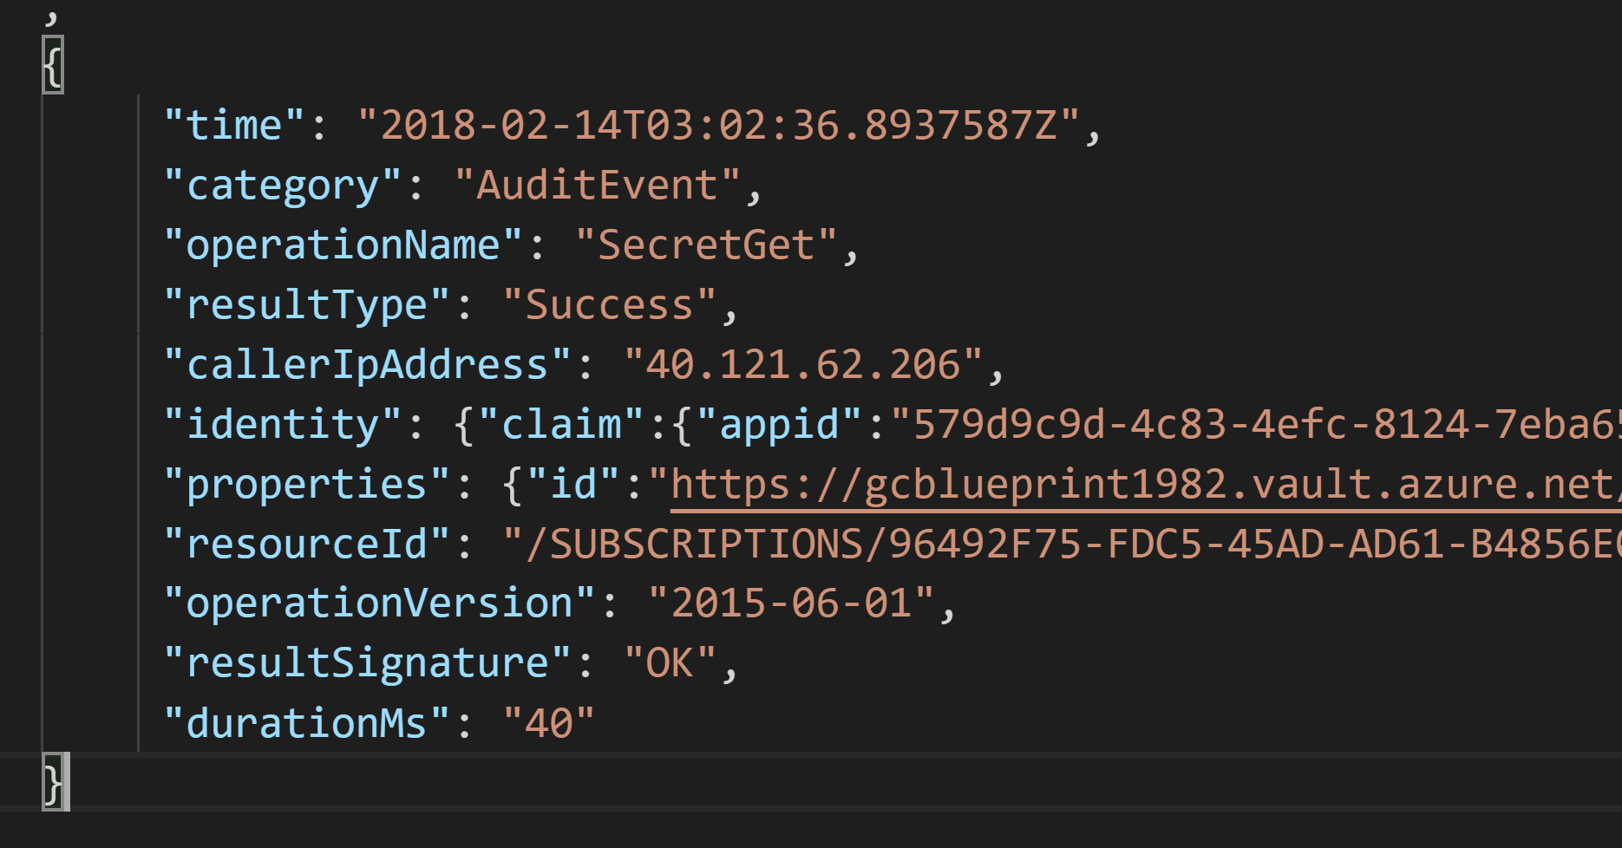
Auditing
Can send Audit Logs to
Storage Account
Log Analytics
Event Hub

Slide 13
Demo
How GC Blueprint implemented Key Vault logging

Slide 14

Azure Storage/Disk Encryption

Slide 15
Azure Storage Service Encryption (SSE)
On by default
Protects Blob & File storage
Encrypts data before writing to the storage and encrypt when reading
Totally transparent from the client
Uses AES 256bits encryption
All key management is done by Azure
Supports all redundancy levels (LRS, ZRS, GRS, RA-GRS)
When enabled on existing account, it encrypts only the new data
Currently in Preview: SSE with custom keys in Key Vaults

Slide 16
Azure Disk Encryption (ADE)
Encrypting the whole disks of Virtual Machines
Supports Windows(Bitlocker) and Linux (DM-Crypt) VMs
Protects against the illegitimate access to machines’ disks
Integrated with Key Vault in the same region. Key Vault is an essential component for this scenario.

Slide 17
Terminology
BEK: Bitlock Encryption Key, used to encrypt the disk. Represented as base64 encoded text. In case of Linux it’s a passphrase of your choice. We will use BEK as generic term in the context of this deck
KEK: Key Encryption Key, used as optional key to encrypt the BEK. Has to be RSA Key either generated from Key Vault and imported into Key Vault
AAD Application: Identity created in Azure AD. Can be used across multiple Azure ADs
Service Principal: The local representation of AAD Application inside your Azure AD

Slide 18

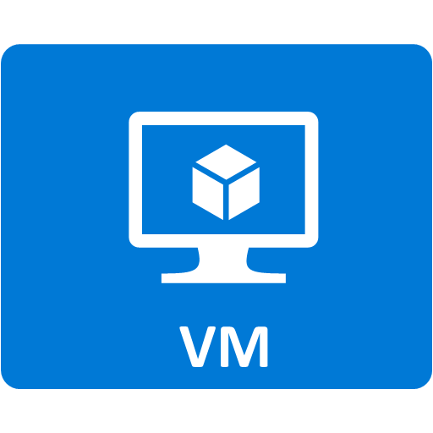



ADE Encryption workflow
Existing VM
Azure Resource Manager should be able to decrypt the boot disk to boot the machine
The BEK is stored in the key vault as a secret
To keep audit trail & control Azure has to have a service principal in Azure AD to be used as identity when interacting with KV
Service Principal
When enable the encryption using extension the BEK will be created
*Optional* We can use a KEK to encrypt the BEK inside KV
Azure RM

Slide 19
Demo
Encrypted Disks

Slide 20
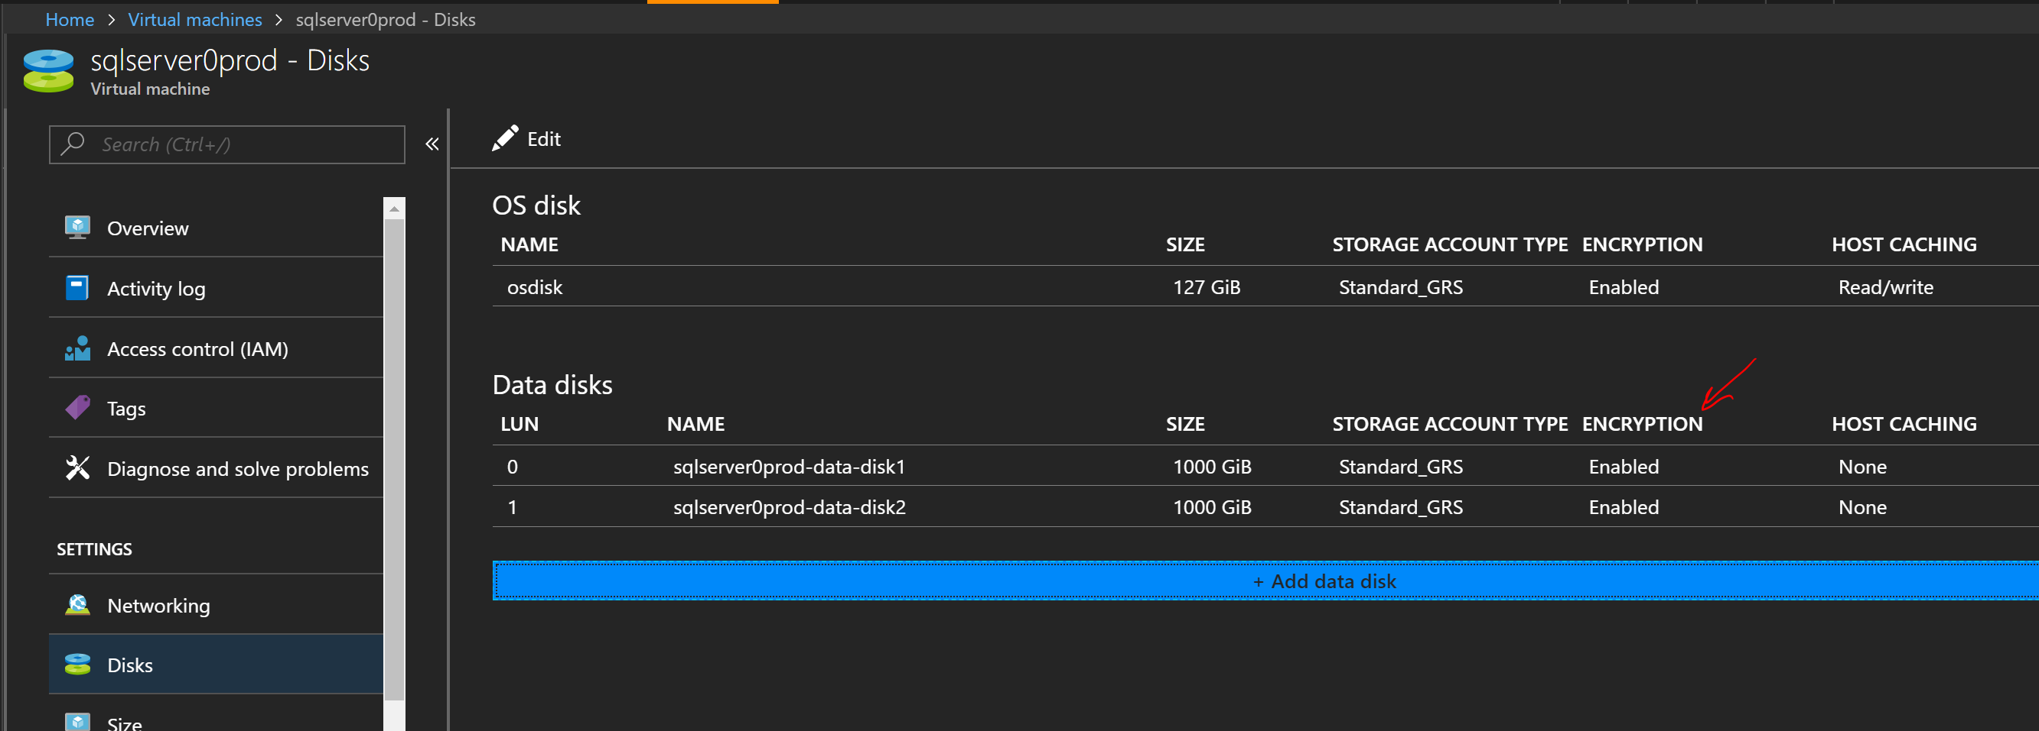
Get Encryption Status
az cli ->
az vm encryption show --resource-group GCBlueprint --name sqlserver1prod
PS ->
Get-AzureRmVMDiskEncryptionStatus -ResourceGroupName GCBlueprint -VMName sqlserver1prod
Portal

